Slide 1
Detecting the Presence of Opioids in Cities
Drew Gobbi, Olivia Wang, Olatunji Akinbule, Maddie Warndorf

Slide 2
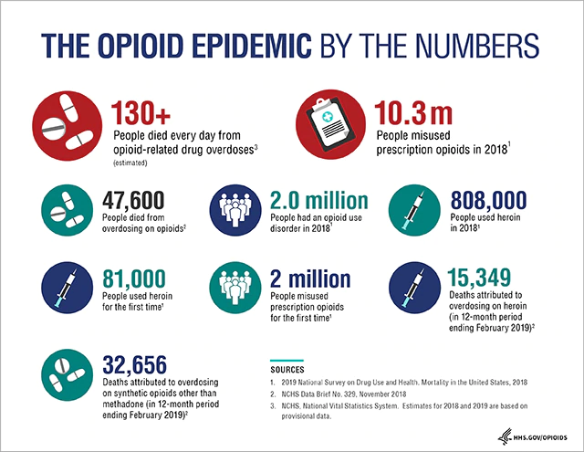
Agenda
Question
Obtaining the data
Maps
Sampling
Constructs
Validity/Reliability
Theory
Proposed design
Limits of our design
Primary analytical method
Predictive regressors
Predictive power
Another approach
Preliminary results
Policy context
Other construct measures
Next steps
What is the U.S. Opioid Epidemic? HHS Department
https://www.hhs.gov/opioids/about-the-epidemic/index.html
Notes:
Maddie

Slide 3
The Question
What factors in a community are associated with high opioid usage?
Constructs Studied:
Opioid Use
Individuals who are in the younger working-age population
Individuals who are male
Individuals who have a college degree or higher
The average median household of the community
Accessibility to health facilities
Logic:
These are ways that opioids can/are being introduced into a community.
Based on the literature analyzed, the demographic features relate heavily to drug use.
Why Would it Matter?
Help public health professionals and policy makers to more efficiently divert resources and improve accessibility of treatment.
Notes:
Maddie
Make sure to cover:
How each construct is measured
Algorithm to test strength
Why would it matter?

Slide 4
Obtaining the Data
Unit of Analysis
The census tracts for each city at a specific month and year.
Theoretical Population
Drug users who live in Arizona and Ohio. This is the population we are looking to generalize to.
Sample Size
Tempe, AZ
440 observations
Cincinnati, OH
1,238 observations
Accessible Population
Drug users who live in Tempe and Cincinnati. The observations in the data represent the drug users we are able to detect and study.
Sampling Frame
The number of EMS calls in Tempe, AZ and Cincinnati, OH. Represents a way to measure drug users within the accessible population.
Notes:
TJ

Slide 5
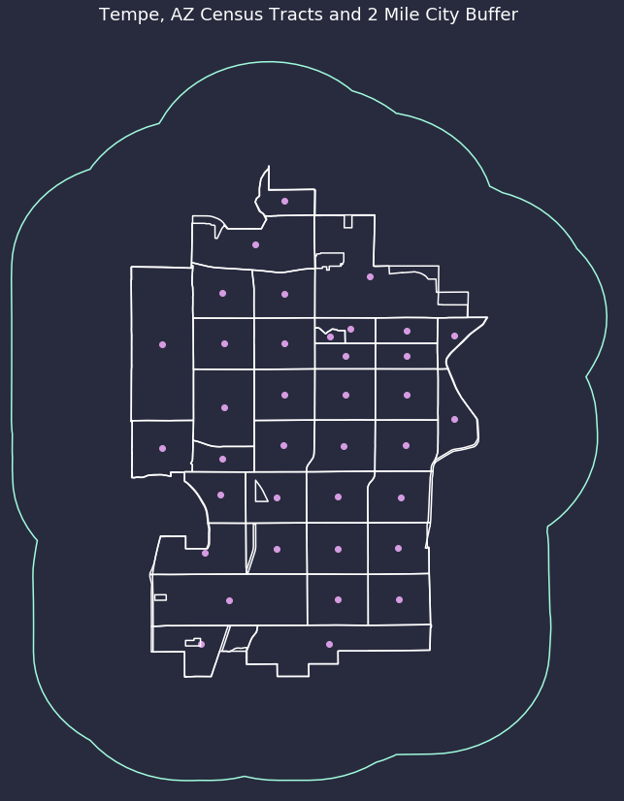
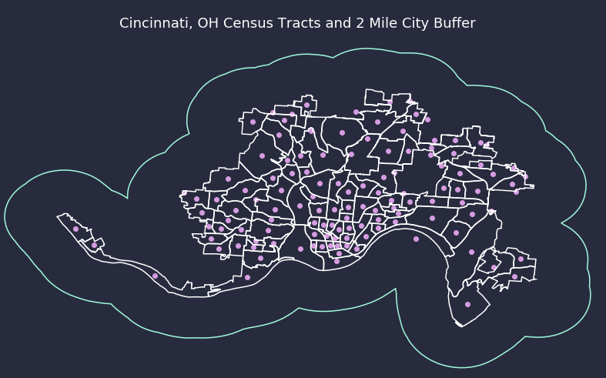
Maps
Notes:
TJ

Slide 6
Sampling
Threats to External Validity
The way that EMS calls are gathered in Tempe, AZ is different from Cincinnati, OH.
Our samples of these two specific cities are not representative of all of Arizona or all of Ohio.
The samples also are not representative of all drug users.
Specific Sampling Strategy
Non-probability purposeful sampling.
Due to our question, we looked into cities that are publishing this data. Tempe, AZ and Cincinnati, OH were the only two that we were able to find that included geographic features to their calls.
Notes:
TJ

Slide 7
Construct | How It’s Measured
Opioid Usage | Number of EMS Calls that are related to opioids in Tempe, AZ (ratio) Number of EMS Calls that are related to opioids in Cincinnati, OH (ratio)
Younger Working-Age Group | Percentage of population that falls into the age group 18-24 per each census tract (ratio) Percentage of population that falls into the age group 25-40 per each census tract (ratio)
Income Level | Median income per each census tract (ratio)
Gender | Percentage of the population that is male per census tract (ratio)
Education Level | Percentage of population that has a bachelor's degree or higher (ratio)
Accessibility to health facilities | Number of health facilities within 2 miles of each census tract centroid (ratio)
Notes:
Olivia
Identify which are independent and dependent variables

Slide 8
Validity/Reliability
Measure | Validity | Reliability
EMS Calls | Has Face Validity Has Content Validity | EMS call data is reliable to certain extent because key features of EMS calls needs to be recorded.
Census Data (age, income, gender, and education level) | Has Face Validity Has Content Validity | Clearly defined and recorded in census data and is the most accepted way of defining and measuring demographic features.
Accessibility to health facilities | Has Face Validity Has Content Validity | All medical facilities (including the pharmacies) have to be licensed, the exact geo-locations of the health facilities could be off by a little but it’s still within a reasonable range.
Notes:
Olivia
EMS Calls:
Face Valid - the number of emergency calls for drug overdoses gives an indicator of how many people are using drugs
Content Valid (harder to establish) - measured by healthcare professionals, but also measured under stress, represents direct detection of drug use but could miss users who don’t go to the hospital
Census Data for Demographic Features:
Face Valid - Census data include the features that we want to use for our analysis
Content Valid - The census data are widely accepted and used as measures for demographic features
Health Facility Count:
Face Valid - People can get opioid at health facilities, and people can get treatment at health facilities Content Valid - categorized by different facility types and counted by category

Slide 9
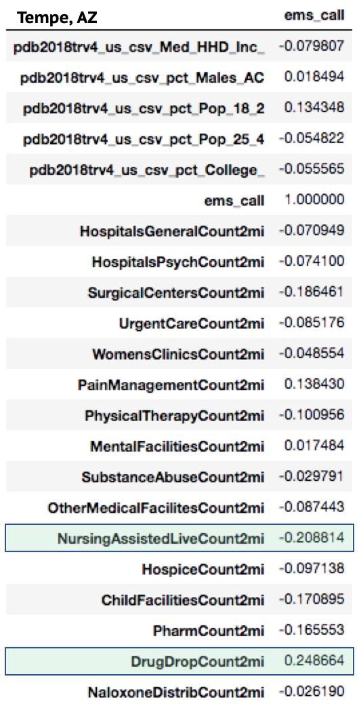
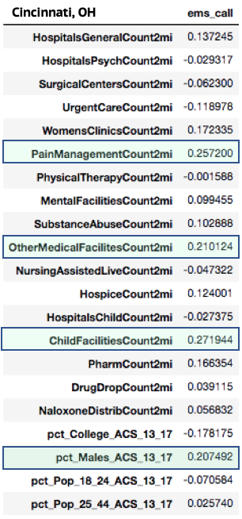
Theory
Certain factors in a community are causing higher opioid usage.
Notes:
Maddie
Stop short of calling this a causal analysis. We are looking for features that may be related to opioid use in order to identify at risk populations
Explain that we know that we know that something is influencing the presence of high opioid usage
We expect time dependent noise in high frequency observations

Slide 10
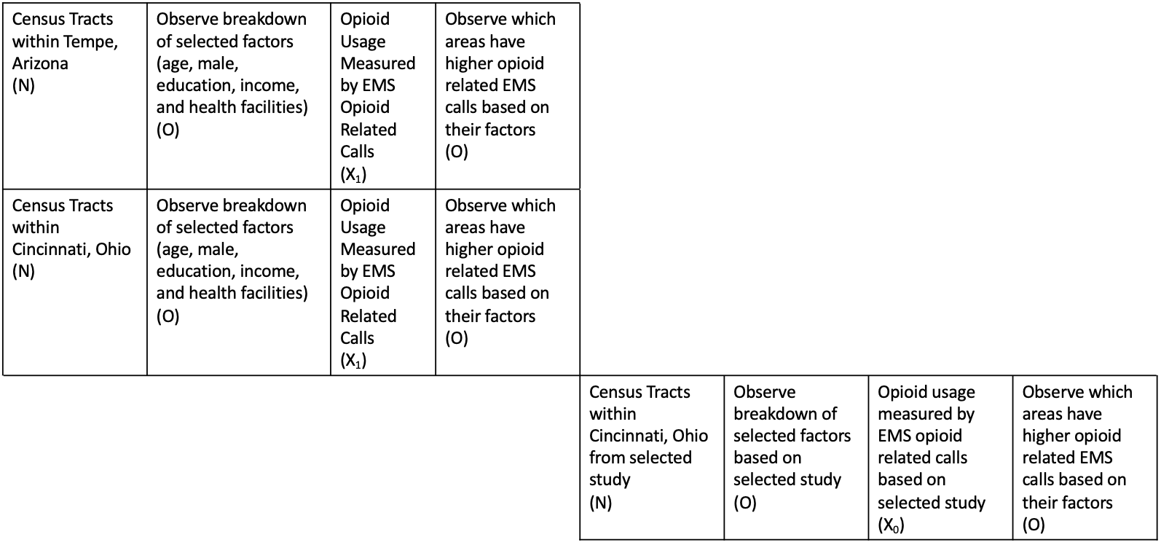
Proposed Design
Equivalent materials quasi-experimental design (with temporal-spatial regression)
A determination of a consistent relationship between the same group of certain community factors and different census tracts & different cities can help bolster our claim that these risk factors are enduring.
Assumes EMS measures have a 1:1 representation with opioid use/users
Notes:
Maddie

Slide 11
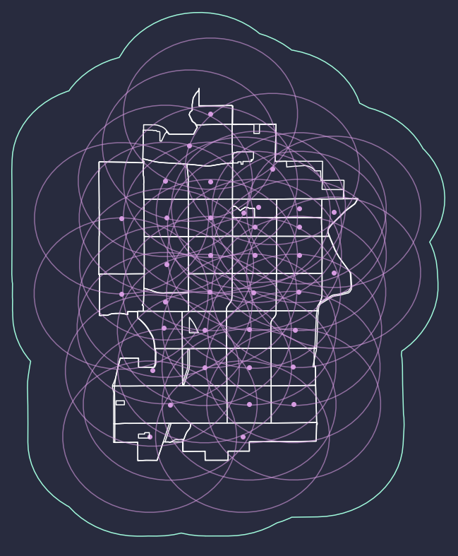
Limitations of Our Design
The size of EMS calls is relative small, especially in Tempe when comparing to the EMS calls in Cincinnati
The EMS calls can be mislabeled, caller reported indications on drug related incidents might be missed on an EMS call
Health Facility geographic locations may not be accurate.
Addressed by adding a 2 mile radius from the census centroid.
Threatens the internal validity:
Potential self-selection of the population into the census tracts we are observing. This may bias our estimates
Inability to distinguish between prescribed and unprescribed use of opioids in our EMS call counts because we are only observing total opioid related call counts.
Notes:
TJ

Slide 12
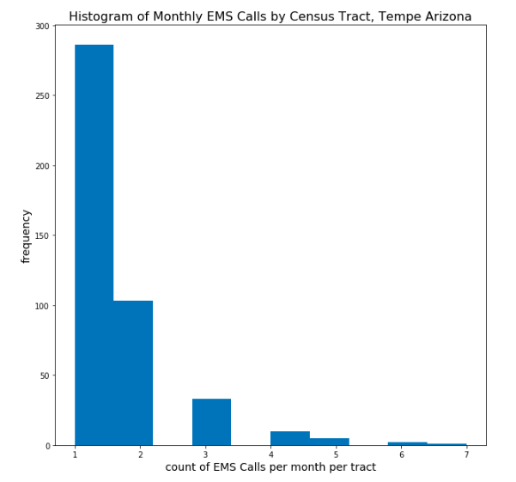

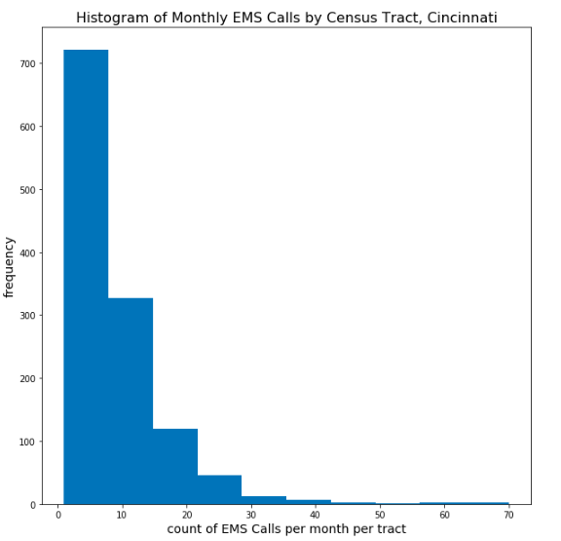
Primary Analytical Method
Leverage a poisson regression model introduced by Li et al. in “Suspected heroin-related overdoses incidents in Cincinnati, Ohio: A spatiotemporal analysis”
EMS Calls
Space
Error
Predictors
Time
Positive relationship between heroin use and population size, proportion of males, proportion of individuals aged 35-45
Negative relationship between heroin use and proportion of individuals aged 18-24, proportion of those with a bachelor’s degree or higher, median household income, and distance to health facilities
Notes:
DREW

Slide 13
Predictive Regressors
We replicate the authors’ findings in Cincinnati, and then extend their model to Tempe to test for generalizability of significant regressors
 | Cincinnati | Tempe
Positive Correlation | 25-44 Population, Males, | Income, Drug Drop Offs
Negative Correlation | College, 18-24 Population, Income, Mental Health, Urgent Care,Naloxone Centers, Drug Drop Offs | College
Statistically Insignificant |  | 18-24 Population, Mental Health, Urgent Care,Naloxone Centers, Drug Drop Offs,25-44 Population, Males,
Notes:
DREW

Slide 14
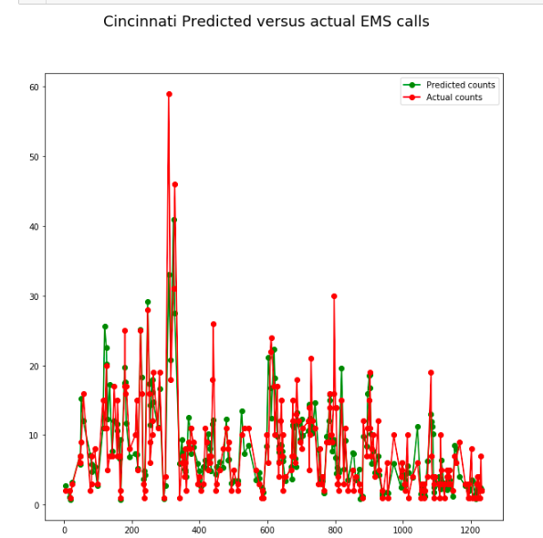
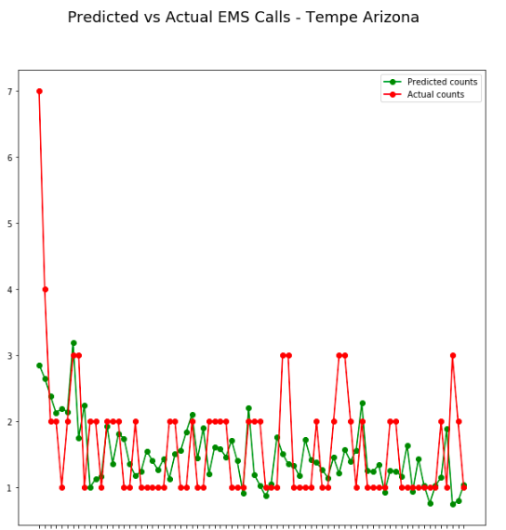
Predictive Power
Notes:
DREW

Slide 15
Another Approach...Classification!
Split the data into two classes - above and below median number of EMS - and classify with a Logistic regression model using the same covariates in each city
 | Cincinnati | Tempe
Positive Odds Ratios | Hospitals, Surgical Centers, Pain Management, Child Care Facilities, and Nursing Assisted Living Facilities | Fails to converge! With insignificant predictors...
Negative Odds Ratios | Psychiatric Hospitals, Children’s Hospitals, Drug Drop Off Sites
Pseudo R2 | 0.1823 | 0.2451
Notes:
DREW

Slide 16
Preliminary Results/Interpretations
Poisson Model:
Regression successfully replicates paper from Li et al. for Cincinnati, but our result shows that the model does not generalize well for Tempe
Policy context reveals that states receive approx. the same amount of funding (per capita-wise), yet have different administrative structures and policy goals
This will be a key feature of our study going forward
Classification:
Limited explanatory power as of now
Cincinnati shows that facilities, relative to democratic indicators
Notes:
DREW

Slide 17
Policy Context/Case Studies
Arizona:
Population:
7.172 million (as of 2018)
Funding:
2017: $75,873,531 in total
2018: $117,058,843 in total
Per Capita: increased from $11 to $17 from 2017 to 2018
Policy Differences:
Improve access and retention in comprehensive MAT service to treat OUD
Increase trauma-informed prevention, treatment, and recovery activities
Increase capacity to provide timely prevention, treatment and recovery resources to the public
Hold bad actors accountable
Ohio:
Population:
11.69 million (as of 2018)
Funding:
2017: $119,030,865 in total
2018: $224,921,519 in total
Per Capita: increased from $10 to $19 from 2017 to 2018
Policy Differences:
Immunity from minor drug possession charges for people who report overdoses
General harm reduction initiatives policies including needle exchanges & infectious disease testing
Safe consumption sites & zones for drug users
Notes:
Olivia
By policy differences, we mean that the policies that one state has that the other state does not have, since that there are a lot of opioid related policies that they have in common
Elaborate the third point:
Decrease the delay between receiving and reporting information like suspected opioid overdoses, suspected opioid deaths, naloxone doses administered, naloxone doses dispensed and neonatal abstinence syndrome from 6 to 18 months to 24 hours
The agency’s secure web-based surveillance systems were utilized for designated reporters to electronically submit mandatory surveillance data
Elaborate the fourth point of policies in Arizona:Holding bad actors accountable by ending pill mills, increasing oversight mechanisms, and enacting criminal penalties for manufacturers who defraud the public about their products;, cracking down on forged prescriptions by requiring e-prescribing
In addition, Arizona is cooperating with ASU on the new measure of opioid use AKA wastewater opioid data (PNML)

Slide 18
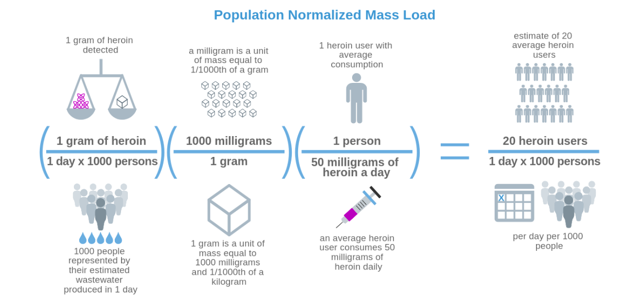
Other Construct Measures - Opioids in WasteWater
As previously discussed, EMS calls are a flawed construct for measuring Opioid Use
Another measure, the Population Normalized Mass Load (PNML) of Opioids in Wastewater is being collected in pilot cities, including Tempe
Reason to believe that PNML is:
A.) More Face-valid than EMS calls as a measure of drug use because wastewater represents total anonymized consumption in an area
B.) Could be a strong predictor of EMS calls or other Opioid-related constructs due to high association
More pilot data needs to be sampled to determine the usefulness of this metric
Photo taken from the City of Tempe and Arizona State University Partner to Study City Wastewater for Public Health Information’s Fighting Opioid Misuse by Monitoring Community Health website. https://www.arcgis.com/apps/Cascade/index.html?appid=92073d7f6a6a498b987f2afdab1b9471
Notes:
Olivia

Slide 19
Next Steps
Deep dive in policy context to determine why predictors of opioid use may differ across cities
Introduction of principal component analysis among census demographic predictors and facility data included in our model → establish convergent-discriminant validity between constructs
Test additional classifiers and parameter tuning to examine reliability of predictors in a variety of designs
Expand analysis to encompass additional cities in the US to test generalizability of findings
Notes:
Drew

Slide 20
In Summary
Question:
What factors in a community are associated with high opioid usage?
Summary of the Design:
The proposed design is a “patched-up” quasi-experimental design with temporal spatial regression.
Limited due to the size of EMS calls in Tempe is relatively small, especially when comparing to the EMS calls in Cincinnati; as well as possible mislabeling of EMS calls and possible inaccurate geographic locations.
Results:
Poisson Model: Regression successfully replicates paper from Li et al. for Cincinnati, but our result shows that the model does not generalize well for Tempe
Policy context reveals that states receive approx. the same amount of funding (per capita-wise), yet have different administrative structures and policy goals
Classification: Limited explanatory power as of now
Cincinnati shows that facilities, relative to demographic indicators are predictive
Notes:
Maddie

